Slide 1
Construction Law Practice
Prof. Carl Circo, Ben J. Altheimer Professor of Legal Advocacy
Forum Text Class notes
Based primarily on Construction Law (Carol J. Patterson, et al. eds., 2d ed., 2019, ABA Publishing)

Slide 2
Overview
(Chapters 1-3 Highlights)

Slide 3
Universal Principles & Issues
Universal principles are overriding themes that frame many legal aspects of design and construction.
Universal issues are the recurring considerations that affect how participants structure and negotiate legal relationships in the industry and that account for many design and construction problems and disputes.

Slide 4
Universal Principles
Context always matters.
Relationships rule.
Participants are (usually) economically rational.
Project quality, schedule, and budget co-exist in considerable tension with one another.
Perspectives derive from the participant’s role:
  Owner;
  Designer;
  Builder;
  Subcontractors and suppliers;
  Lender;
  Insurer;
  Surety.
Notes:
Context always matters: the industry itself is the essential context, with variations for residential, general commercial, retail, industrial, heavy construction, public works; the industry context is constantly being affected by dynamic circumstances, and has been shaped by a relatively few transformational events (text, 101 B).

Slide 5
Universal Issues-Level 1 (Basic)
Project definition
Scopes of work and services
Pricing
Risk allocation
Risk management

Slide 6
Universal Issues-Level 2 (Derivative of Level 1)
Project delivery system
Project administration
Schedule controls
Payment process
Site conditions and other surprises
Changes
Warranties and performance assurances
Payment security
Indemnities
Insurance
Defaults and remedies

Slide 7
Perspectives revisited
Contemporary construction is a highly collaborative process that takes place in an intensively competitive and individualistic environment under circumstances of high risk and low certainty and over an extended duration.
An effective construction lawyer understands and takes account of:
  The client’s perspective;
  The perspectives of the other participants contracting with the client;
  The perspectives of the other participants who have no direct contractual relationship with the client but with whom the client has significant project relationships;
  The overall context of the construction industry.

Slide 8
Perspectives Revisited-Owner
Quality may mean, in varying degrees: function; aesthetics; comfort; durability; reliability; and performance.
The project must be completed on time.
Costs must remain within budget.
No surprises.
Priorities and risk tolerances on each of these competing concerns vary from owner to owner and project to project.

Slide 9
Perspectives Revisited-Builder
General contractors manage risk for profit.
Risks must be quantifiable and manageable.
Compensation should reflect risk assumed.
The scope of work must be adequately defined.
Section 3.04—the Spearin Doctrine is one of the landmarks of construction contract law.

Slide 10
Perspectives Revisited-Subcontractors and Suppliers
Scope of work is paramount.
Risk management can be tricky at this level.
Subs have relatively little bargaining leverage.
Payment security is key.

Slide 11
Perspectives Revisited-Design Professional
The scope of services must be well defined.
Professional interests often include:
  Professional prerogatives; and
  Intellectual property rights.
Relationships with other participants are complex.
Professional liability risks are significant.

Slide 12
Perspectives Revisited-Lender
Lenders extend credit for profit; they do not wish to be partners in the project.
Construction lending is risky because:
  Uncertainties abound;
  The project’s collateral value is speculative;
  Default workouts are difficult.
Project financing is even riskier than traditional construction lending:
  Non-recourse to the project owner, with loan repayment to come from revenues of the completed project;
  Common only in certain infrastructure and other public projects—especially common in developing countries.

Slide 13
And there are others
Insurers
Sureties
Equity investors
Purchasers
Tenants and other end users
Land use authorities
Regulatory agencies
The public
Notes:
The next slides (on project delivery systems) go with Chapter 4, week 2).

Slide 14
Project Delivery Systems
Chapter 4 highlights
Design-Bid-Build
Design-Build
Engineering, Procurement, & Construction
Multiple Prime
Construction Management
Project Management
Build-Operate-Transfer
Fast Track
Bridging
Integrated Project Delivery
Many other variations
Notes:
Note “selection factors” and risk factors” for each system as identified in the text. Different systems are better suited for certain contexts than others. A project delivery system is selected in light of the particular context and helps to define the legal and practical relationships among the participants.

Slide 15
Design-Bid-Build System
Owner
Design Professional
Prime Contractor
Subcontractors

Slide 16
Design-Build System
Owner
Design Builder
Design Services
Construction Services

Slide 17
Construction Management System
(one variation)
Owner
Design Professional
Construction Manager
Contractor
(with subcontractors)
Contractor
(with subcontractors)
Contractor
(with subcontractors)

Slide 18
Contracting principles
Chapter 5 Highlights
Contract law represents an overarching aspect of the legal context for the industry; these are a few especially important considerations:
  Services and work often start before contracts are signed;
  Certain industry forms (especially AIA forms) dominate, but do not always fully reflect the considered agreements of the parties;
  Common contract structures reflect some industry customs and practices;
  “Contract documents” refers to more than legal terms and conditions;
  Bid packages, drawings, specifications, proposals, clarifications, and qualifications all serve distinct roles;
  Legal relationships often arise outside of the formal contracts (e.g., think tort duties and third-party beneficiary theory).
Notes:
These points are primarily from Chapter 5. This may be a good time to reference Stipanowich; and for a long-term idea (book?), note the paragraph following footnote 63, which conjures “the concept of a law of construction contracts.” His article provides a good summary of contract issues and the contractual contexts in which the construction industry operates.

Slide 19
The design undertaking
Ch. 6 highlights
For commercial projects, design is typically provided by and through a project architect.
For industrial and heavy construction, design is typically provided by and through a project engineer.
The design team = the project design professional and a group of consultants in specialty designs.
Geotechnical engineers are commonly retained separately by the owner.
Building codes are normally adopted locally.
Green building codes and sustainable design are hot topics.
Section 6.04 is especially important: professional standard of care.
Proof of design malpractice normally requires expert testimony on the standard of care and breach of that standard.
Notes:
These notes are highlights from Chapter 6.

Slide 20
More on design undertaking
A failure to comply with applicable codes may be malpractice per se.
In most jurisdictions, no implied warranties are read into design contracts; contrast this to the Spearin Doctrine.
Value engineering is an important concept to understand—it is often done by the contractor and not by an engineer.
Know the distinction between design specifications and performance specifications.
Specialty subcontractors often work on a design-build (performance specification) basis, even on a design-bid-build project.
Notes:
Questions on page 153 are good for review.

Slide 21
Design agreements
Architectural services agreements typically encompass several distinct design phases.
A usually expects to rely on O’s approval of the design at each phase—meaning that A receives additional compensation if O later wishes to change something covered in approved plans and specifications.
In one approach to defining the scope of services, the contract fee covers specified basic services, while additional services require additional compensation.
In a D-B-B delivery system, the project architect commonly assists the owner during the bidding or contractor negotiation process and in contract administration.
O may be responsible for securing certain consulting services, tests, reports, and inspections.
Notes:
These notes are tied to Chapter 7. As an example of the basic-additional services approach, consider green building services, which may be included only on an additional compensation basis or, perhaps, completed excluded from A’s responsibilities.

Slide 22
More on design agreements
The budget risk is normally on O and not A.
If A agrees to design to a budget:
  What are the alternative remedies if the bids come in high?
  What are the implications of the betterment doctrine?
Notes:
Does the betterment doctrine normally mean that O will be stuck paying the higher costs no matter how poorly the designer performed in providing estimating and budgeting services?

Slide 23
More on design agreements
Ownership of the design documents requires some elaboration.
Contractual liability limits are especially important.
Contract terms dealing expressly with termination are common.
  They often include O’s option to terminate without cause.
  Be sure that these provisions make economic sense from your client’s perspective.
Notes:
Point out that most of O’s claims may be for consequential damages.

Slide 24
Architect’s contract administration chapter 7 highlights
Key points to keep in mind:
  The chapter reflects the most common contract administration arrangement for commercial projects using the design-bid-build system.
  This is the AIA’s approach; for a major contrast, see ConsensusDocs 200.
  AIA approach has A function variously as O’s representative, O’s advisor, or a neutral arbiter between O and C.
  Note the liability risks associated with A’s contract admin.
  I’m fond of the questions on page 223.

Slide 25
Contractor selection
Chapter 8 highlights
Be sure that you understand the main contrasts between the contractor selection process for public projects as compared to private ones.
  Chapter 8 mostly concerns public projects, especially those governed by public bidding statutes and regulations.
  True competitive bidding for public projects is highly structured.
  Note the connection between the competitive bidding process and the Design-Bid-Build project delivery system.
  Public works projects constitute a subspecialty in construction law practice; more on this in Chapter 23.

Slide 26
More on Contractor Selection
Key concepts and terminology that apply to private as well as public projects:
  Bid package;
  Project manual;
  Alternates;
  Allowances;
  Addenda;
  Bid bond;
  Bidder’s exceptions, qualifications, & requests for clarification.

Slide 27
Pricing Construction Contracts
(Chapter 9 highlights)
Pricing mechanisms:
  Allocate economic risks;
  Impact many other contract terms.
Stipulated sum contracts considerations:
  Scope of work becomes super-critical;
  Potentially conflicting economic incentives for O & C;
  Importance of progress payment terms;
  Role of a schedule of values;
  O’s additional risk if C gets ahead on payments.
Cost-plus contracts:
  Require comprehensive definition of “cost of the work;”
  “Plus” accounts for C’s overhead and profit.

Slide 28
More on pricing
Estimates often operate as caps, subject to adjustment with O’s consent.
Guaranteed maximum price (GMP) contracts blend cost-plus pricing with a stipulated sum element.
Related concepts:
  Unit pricing;
  VEQ clauses;
  Unbalanced bidding;
  Change order pricing;
  Allowances, contingencies, budgets, audit rights.

Slide 29
Subcontractors & suppliers chapter 10 highlights
Do you understand the distinction between a subcontractor and a supplier & why that distinction may have important legal consequences?
Some owners want input into the process of selecting subs and suppliers—do you see how owner participation has different implications depending on the delivery system and pricing structure?

Slide 30
More on subcontractors
Subcontractor bids in the industry context:
  Classical offer and acceptance theory can be problematic—enter promissory estoppel.
  Bidding sins: bid chiseling, bid shopping, and bid peddling.
Flow-down and flow-up contract terms—the AIA example is worth discussing.
The conditional assignment of subcontracts—an important consideration for O and the construction lender.

Slide 31
More on subcontracts
Recall that relationships rule and that general contractors manage risk for profit.
Coordination of subcontractors is a key to managing the risk—e.g, scheduling, staging areas, and many other administrative aspects.
The role of indemnities:
  The AIA example illustrates;
  Among sophisticated parties with sufficient bargaining power, indemnities may be heavily negotiated;
  Anti-indemnity statutes are increasingly common.

Slide 32
more on subcontracts
Allocating the risk of O’s payment default—who takes the credit risk?
  Many conflicting cases and some alternative statutory approaches.
  Pay-when-paid clauses.
  Pay-if-paid clauses.
  Judicial approaches, including the trust fund theory.

Slide 33
More on subcontracts
Subcontractor claims:
  Claims are common, and often lead to litigation or arbitration;
  They do not necessarily present the theoretical challenges that the historical review in chapter 10 suggests;
  Common industry forms and other well-drafted contract terms often provide workable solutions.

Slide 34
Contract time & completion chapter 11 highlights
Understand the significance of a time is of the essence provision in the construction industry context.
The advent of scheduling as a matter of technical expertise is one of the transformative events in construction law history.
  Critical path method (CPM) is dominate and you must understand the concept;
  Delay claims are frequently litigated or arbitrated and industry lawyers must learn how to deal with CPM analysis and expert testimony on delay claims.

Slide 35
More on contract time
Note common grounds for extending the contract time (i.e., excusing C from liability for delays):
  Two key questions—
    Did the event actually cause a delay in completion?
    Who caused the delay or had control over the event?
  Delays may be:
    Compensable;
    Inexcusable;
    Excusable.
  Note the delay-disruption distinction
    Delay refers to events that extend the project completion date.
    Disruption concerns events that adversely affect productivity.

Slide 36
More on contract time
Common contract terms relating to delays and disruptions:
  C is typically required to take certain foreseeable delays into account when agreeing to the contract time—(AIA and ConsensusDocs take different approaches);
  Contractual force majeure clauses are common—note U.S. v. Brooks-Callaway, p. 336—foreseeable high-water condition was not a “flood” excluded by the clause.
  Substantial completion and final completion are important terms of art;
  Liquidated damage provisions offer one risk allocation solution—but there are some limits on enforceability.
  No-damage-for-delay clauses:
    Allow C the possibility of a schedule extension, but not extra compensation;
    These clauses are often heavily negotiated;
    They are not always enforceable.

Slide 37
Construction scheduling
Bar chart schedule is different from a CPM schedule.
Float is an important concept: Who owns (or should own) the float?
Utley-James, Inc. case (p. 323) offers a practical discussion of CPM analysis, including:
  Early start, late start, early finish, late finish;
  Float;
  An activity with no float is on the critical path;
  An activity can move from off the critical path to on it;
  How to address delays in critical path activities—extend the completion schedule or accelerate activities.

Slide 38
More on scheduling
Standard schedule specifications:
  A potentially important aspect of the contract that is sometimes overlooked.
  The project architect or engineer may include schedule terms via supplemental conditions in a project manual.
A baseline or as-planned schedule:
  The as-planned schedule is often C’s responsibility by contract.
  Regular schedule updates—also often C’s responsibility— should take into account the effects of delay as they occur.

Slide 39
Delay analysis
Under the classic technique—
    compare (reasonable) as-planned schedule with as-built;
    Identify the delaying events;
    Determine the cause(s) of the delays;
    Assess the effects of the delays.

Slide 40
More on delay analysis
From The Forum text
Competing methods for proof of delay claims
  1. Bar chart—can illustrate a simple delay impact, but it does not help with relationships between tasks and events.
  2. But for analysis/collapsed as-built—one party adjusts the as-built schedule by removing delays by the other side, then updates the CPM and concludes that but for the other party’s delay, the project would have been finished on X date.
  3. Total time analysis—a gross simplification that compares the as-planned schedule with the as-built schedule, points out delays the other side caused, and concludes that the variance between as-planned and as-built must have been caused by the other party’s delay.
  4.Impacted as-planned analysis—takes the delaying events in isolation and adjusts the as-planned schedule accordingly without reference to the as-built picture.

Slide 41
Competing methods continued (from the forum text
  5. Chronological and cumulative approach/time impact analysis—starts with updated CPM schedule (not the original, as-planned one) just before the delay in question and adjusts for each delaying event as it occurs (at least, that’s the theory). Problem: this method may disguise concurrent delays.
  6. Window analysis—like #5 except that the updates are not necessarily keyed to pre-selected delaying events but instead are taken from milestones (say monthly schedule updates required by the contract); then, for a period subsequent to the update (the window period), the analysis adjusts for all delaying events during that period.
More on delay analysis
From The Forum text

Slide 42
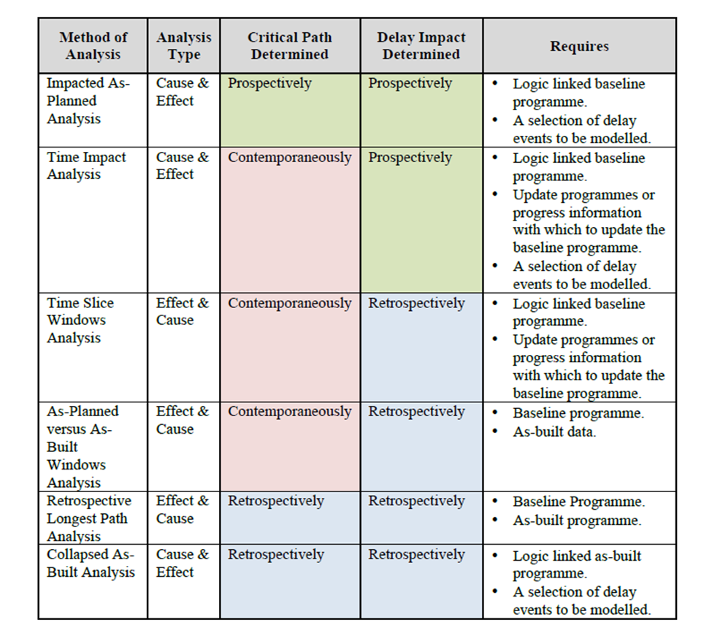
Competing Methods Continued
Society of Construction Law Delay and Disruption Protocol CHART

Slide 43
Delay analysis wrap-up
The CPM Expert and the Need for Impartiality—lessons for the litigator:
Assume that the opposing expert is manipulating the data to support the position of the party employing the expert.
The literature is filled with references to “garbage in/garbage out” and “junk science.”

Slide 44
Payment
Chapter 12 highlights
There is some duplication here with previous chapters, but the chapter introduction makes some important practical points:
  Construction is all about the flow of funds—usually beginning with the construction lender;
  GC and subs effectively “finance” some aspects of the project because they must wait to be paid for work and materials they have provided and supplied;
  Subs are frequently squeezed most intensely in a financial sense, which may tempt them to use funds paid on one project to pay overdue bills from another project;
  Project success may depend on getting contractor, subs, and suppliers paid promptly.

Slide 45
Payment continued
The Federal False Claims Act deserves careful review.
Lender liability suits wax and wane depending on the economic times.
  Construction lenders do not lose many cases based on approving or refusing to approve payments.
  But the current bad reputation of lenders based on the mortgage loan crisis seeps into court decisions.

Slide 46
Payment discussion questions
Review the GMP provisions of ConsensusDocs 410.
By what process and at what time is the GMP established (Section 3.2)?
How is the owner protected if GMP exceeds the owner’s budget?

Slide 47
Payment continued
Stipulated sum pricing is common with design-bid-build; schedule of values is often key feature.
Cost-plus pricing is used with any delivery system; “cost of work” needs to be defined carefully.
Progress payment process under any system:
  Often involves architect and lender review;
  Special lender requirements on disbursement should be reflected in O-A and O-C (or O-D/B) contracts.
  Retainage is a major item, and often negotiated;
  Some states regulate retainage to protect contractor and subs on both public and private projects and to protect (up to a point) public owners on public works.

Slide 48
Payment continued
Other special payment process concepts:
  Punchlist procedure, which may involve special withholding, apart from retainage;
  Construction lien rights and procedures dovetail with payment issues—we study lien rights & process later.
  Surety bonds also may tie into payment procedures, e.g., obtaining consent of surety may be required or prudent as a condition to releasing retainage and making final payment.

Slide 49
Construction safety
Chapter 13 highlights
Accident prevention—our focus is on government laws and regulations, especially the federal Occupational Safety and Health Act (OSHA)
  OSHA treats a general contractor as an employer of subcontractors’ employees (based on control).
  OSHA inspections and regulatory enforcement actions can be significant events for contractors and subcontractors.
  OSHA violations may be evidence of negligence.

Slide 50
Compensation for accidents
Workers’ Compensation statutes create a regulatory system in which workers gain from employer’s statutory liability and employers gain from statutory limits on that liability.
Who counts as an employer for workers comp purposes?
Injured workers can still pursue tort claims against those other than the employer who may be at fault.

Slide 51
Tort liability for accidents
Aside from liability under workers’ comp laws, tort law governs construction accidents.
A project owner who does not control the project site and is not actively involved in project safety is typically not liable in tort for accidents, but the facts of the specific case matter.
Design services agreements usually exclude responsibility for construction means, methods, techniques, and safety—those contractual provisions often provide a defense to the design professional, but again the facts matter.

Slide 52
Safety & Risk allocation
Insurance:
  Especially workers compensation insurance policies and commercial general liability policies;
  Contracts often specify that an insured (say the general contractor) will name other participants (say the owner) as additional insureds under a liability policy.
Contractual indemnities:
  Courts generally read indemnities narrowly and are especially hostile to indemnities that purport to protect the indemnitee against its own negligence.
  Many states have “anti-indemnity” statutes limiting contractual indemnities specifically in design and construction contracts.
  Workers’ comp insurance programs may insulate employers who maintain the statutory insurance from indemnity and contribution claims by other potentially responsible parties—unless the employer has waived the defense.

Slide 53
Changes
Chapter 14 highlights
Construction contracts differ from many other common contracts because one party (the owner) ordinarily reserves the power to make unilateral decisions to change the obligations of the other party (the contractor).
The change clause or section of the contract is primarily about the process that determines how a change affects schedule and price.
It is often critically important for the contract to specify who (the specific representative of a party) can bind either party to a change.

Slide 54
Changes continued
Contractual change order provisions are extremely important, BUT
  Many cases set a low bar when a party—usually the contractor—claims that the other party has waived adherence to the formal process or is estopped from relying on that process: beware of loose oral statements and patterns of conduct that
    Seem to waive strict compliance with contract terms or
    Create a basis for a detrimental reliance argument.

Slide 55
Changes continued
Constructive changes are, in effect, deviations from the contract by the owner that give the contractor a claim for an adjustment of the price or schedule or both.
A cardinal change is a material breach of contract by O because it forces C to perform work that C has a right to refuse to perform—the additional work is beyond the intended scope of the work contemplated by the contract.
AIA A201 Article 7 in the Forum Text provides a comprehensive scheme for dealing with changes; Article 15 applies in the case of a constructive change.
ConsensusDocs 200, Article 8 provides an alternative approach.
Questions at p.p. 454-455, while a bit contrived, raise some of the most important recurring issues.

Slide 56
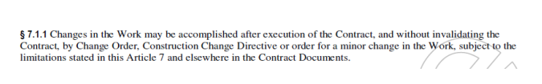
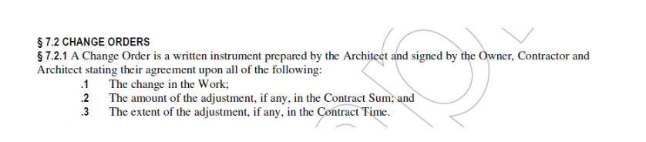
AIA A201 and changes

Slide 57
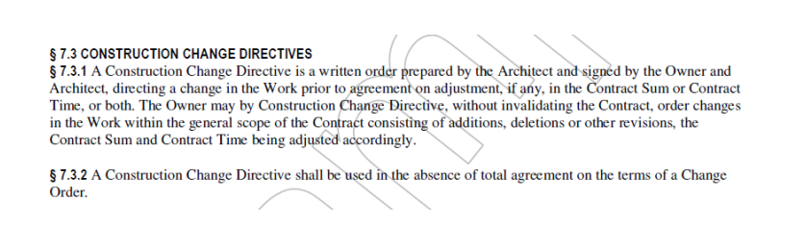
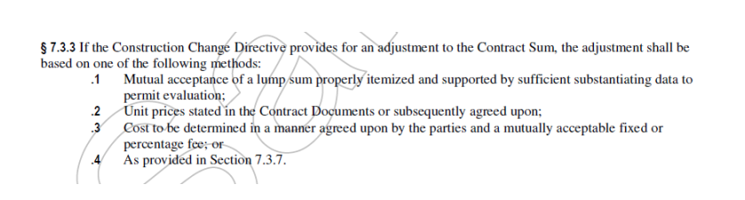
AIA A201 and Changes

Slide 58
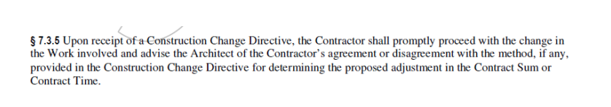
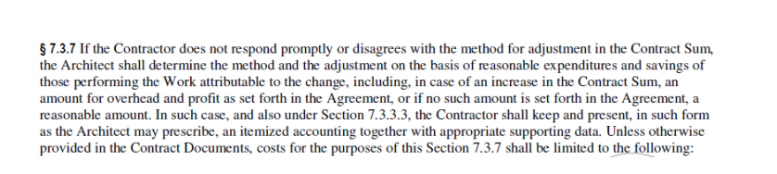
AIA a201 and changes
[Costs include these items attributable to the change: labor, including fringe benefits; materials, supplies & equipment; rental costs for machinery & equipment; premiums for bonds & insurance; related fees & sales tax; costs of additional field supervision.]

Slide 59
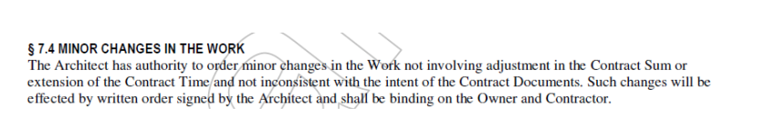
Aia a201 and changes

Slide 60
Differing site conditions chapter 15 highlights
How to allocate the DSC risk?
  Under the common law, with a stipulated sum, C bears it.
  Note various legal theories that might apply, especially superior knowledge and concealment.
  C will accept risk for adequate compensation—leading to a wasteful DSC contingency in the bid.
  In most circumstances, both O and C benefit from reallocating the risk to O.
As is true with many recurring problems in the industry, well-drafted contracts anticipate the DSC risk, allocate it based on common expectations, and proscribe a process to deal with the risk.

Slide 61
DSC Risk continued
Common contractual approaches in private projects:
  FAR 52.236-2;
  AIA General Conditions, A201, 3.7.4 in Forum Text;
  Note that federal project contract law and practice (via FAR) led the way to the prevailing DSC practices.
Classic analysis of a DSC claim:
  Type I—conditions are materially different than what the contract documents indicate;
  Type II—unknown conditions of an unusual nature.

Slide 62
Termination and default chapter 16 highlights
Termination by Contractor for cause, compare
  ConsensusDocs 410 with
  AIA provisions in text.
Termination by Owner for cause, compare
  ConsensusDocs 200, Section 11.3 with
  AIA provisions in Forum Text.
Termination by Owner for convenience:
  Why might O want this option?
  How well does ConsensusDocs 200, Section 11.4 deal with the situation—for C?—for O?

Slide 63
Termination and default continued
Mustang Pipeline case, p. 501:
  Applies basic contract law in simple situation—when time is made of the essence by contract, C’s late completion is a material default;
  O thus has option to terminate the contract and be relieved of further obligations to C.

Slide 64
Mechanic’s liens
Chapter 17 highlights
Terminology:
  Traditionally, “mechanics’ liens” or “mechanics’ and materialmen’s liens;”
  More modernly and descriptively, “construction liens.”
Basic principles:
  Creatures of statutes; unknown at common law;
  Statutes vary greatly;
  Technical rules govern creation, perfection, enforcement;
  Statutory procedures strictly construed against lien claimant—claimant must precisely comply with statutory requirements;
  Relation back and first spade rules;
  A valid lien is a charge on the project, encumbering title;
  Ultimate remedy is foreclosure (similar to a mortgage).

Slide 65
Common lien questions
Are claims of subs and suppliers merely derivative of the direct contractor’s lien rights, such that O’s payment to contractor defeats the lien claim?
Or can lien claims effectively force the owner to pay for the same work twice—once to direct contractor and once to subs or suppliers?
Who may assert a lien?
  Statutes vary on this in many respects;
  Usually the direct contractor, plus 1or 2 tiers of subs and suppliers.
What kind of work or service is lienable?
What notices and filings apply?
Do different procedures apply in different circumstances (e.g., a special set of procedures for residential or consumer projects)?
To what property does the lien attach?

Slide 66
More common questions
How does a lien right apply in the case of a tenant’s improvement of leased property?
What priority will a lien have?
  Priorities among ordinary mortgages, construction mortgages, judgment liens, and construction liens.
  Relative priority of liens by different subs and suppliers (remember the first spade rule, if applicable).
Does the jurisdiction afford alternative payment security for those working on public projects?
How can the liens be waived or released?

Slide 67
Construction liens and bankruptcy
If the project owner files a bankruptcy petition:
  A claimant with a lien perfected prior to the filing generally has the status in bankruptcy of a secured creditor.
  Automatic stay prevents lien claimant from enforcing the lien without obtaining relief from the stay.
  A claimant who has not already taken the steps necessary to perfect the lien usually will be able to take action to perfect as provided for under state law.

Slide 68
Insurance and bonds chapter 18 highlights
Be sure you can distinguish between insurance and bonds and the different roles they play in the industry.
Here are several key points concerning insurance:
  Variety of risks covered by different insurance categories, such as CGL, builders’ risk, professional liability, workers’ compensation;
  Standard insurance requirements in a construction contract (A201 provisions illustrate);
  Waiver of subrogation.

Slide 69
Commercial General Liability insurance
Summit Custom Homes case, p. 562, is a nice introduction to technical nature of CGL coverage litigation.
  An aside—EIFS, a building exterior cladding system, has produced a wave of defect litigation.
  Contrast occurrence policy to claims made policy.
  What is the “eight corners” rule re duty to defend?
  What constitutes “property damage” under CGL policy?
  What is an “occurrence” under CGL policy?
  What is the “business risk” doctrine re property damage?
  You can understand the result in the case if,
    First you accept the court’s “manifestation rule” and
    Then you work through the mechanical analysis of the CGL policy coverage and exclusions—the pleadings allege property damage arising out of work by subs, thus resulting from an occurrence; evidence is required to determine whether the property damage manifested during the coverage period of any of the 5 policy years, thereby potentially giving rise to duty to defend.

Slide 70
Construction bonds
A surety issues a bond as financial security for obligations of the principal.
Common forms of construction bonds:
  Bid bonds;
  Payment bonds;
  Performance bonds;
  Completion bonds.

Slide 71
Construction bonds continued
St. Paul Fire & Marine v. City of Green River, p. 572
  Nutshell: S proposed to proceed in accordance with its options under the bond; because O’s actions deprived S of its rights under the bond, S’s obligations were excused.
  What options did S have under par. 4 of the bond?
  Do you see how par. 5 of the bond effectively modified the construction contract obligations that S undertook to perform under the bond?
  Accepting the facts as found by the court, the case mostly reflects black letter suretyship law.
  What advice would you have given Dr. Oliver about responding to S’s proposal?

Slide 72
Pearlman v. Reliance, p. 580
The surety’s equitable subrogation rights were key—the retainage was not part of the bankruptcy estate of the defaulting contractor.
If there had been no bond, who would have had rights to the retained funds & on what legal basis?
Although the case was decided under the old Bankruptcy Act, the controlling principle derives from suretyship law, not bankruptcy law:
  The owner, contractor, laborers and materialmen all had equitable rights to the retainage fund;
  By honoring its obligations under the bond to pay the contractor’s debts, the surety stepped into the shoes of those who had rights to the fund (subrogation).
Note subcontractor default insurance alternative to bonds.

Slide 73
Dispute resolution processes
Chapter 19 highlights
In thinking about dispute resolution processes in the industry, remember that relationships are everything.
Industry contracts have long provided for work to continue in the face of unresolved disputes.
Strategic alliances and integrated project delivery try to create incentives for participants to cooperate.

Slide 74
Dispute resolution continued
Note Dispute Resolution Step Chart (p. 590).
  Mediation as a condition precedent to arbitration or litigation is common.
  Stepped negotiation as a condition precedent to mediation is beginning to gain support.
  Dispute review boards and standing neutrals seem to hold promise for high-dollar projects.
The chapter authors obviously have an agenda to promote.

Slide 75
Dispute resolution continued
For a generation or more, industry lawyers have commonly favored arbitration over litigation, although there is a recent contrary movement.
  Arbitration may be less expensive;
  Or not;
  Arbitration may be quicker;
  Or not;
  Arbitrators typically understand the industry and its customs and practices better than judges and juries;
  The key disadvantage is that arbitration awards cannot be overturned simply due to error of fact or law.

Slide 76
Dispute resolution continued
Basic arbitration principles:
    Mandatory arbitration is a matter of contract.
    The Federal Arbitration Act and state arbitration acts broadly favor arbitration and generally make arbitration agreements enforceable.
    The U.S. Supreme Court’s decisions also generally uphold mandatory arbitration agreements.
    The grounds for attacking an arbitration decision are extremely limited, essentially only:
      Matter in dispute being outside scope of the arbitration agreement;
      Arbitrators’ failure to adhere to mandatory procedures;
      Arbitrators exceeded their power;
      Corruption or fraud.

Slide 77
Dispute resolution continued
The arbitration agreement may address key features of the process:
  Number, qualifications, and method of selecting arbitrators;
  Availability and extent of discovery;
  Place of arbitration;
  Law applied;
  Arbitration rules to be followed (such as AAA’s Construction Industry Rules);
  But in Hall Street case (p. 609), U.S. S. Ct held that the parties may not vary the FAA standard of judicial review.

Slide 78
Defective construction chapter 20 highlights
Defects account for a large percentage of construction disputes.
We won’t take much time to discuss the cases.
Section 20.01 Overview
  At p. 613: “manifestations versus defects” is important.
  Responsibility (p. 614) yields much of the legal work.

Slide 79
Defective construction continued
Section 20.02 O vs C
Contract
  Failure to comply with plans and specifications;
  Breach of express warranty;
  Breach of implied warranty:
    General implied warranty;
    Enhanced implied warranty for residential construction.
Tort
  Preliminary question: Is there a tort of negligent construction?
  The rest of the complex story is mostly for Chapter 21.

Slide 80
Defective construction continued
More on O v C
Statutory claims
  Deceptive trade practices legislation mentioned in the text is only one statutory basis for defect claims.
  Another important area involves violation of building and safety codes—a potential basis for per se liability.
Notice requirements
  We have already seen typical contract claims procedures, with notice and cure procedures.
  Some states delay right to litigate pending specified procedures, especially for residential construction.

Slide 81
Defective construction continued
Section 20.03 Against Design Professionals
Tort and contract claims generally:
  An interesting history that has favored tort claims;
  Almost any activity by a design professional on a project involves a duty of professional care;
  Some situations raise difficult questions about the nature or extent of the duty (e.g., design professional who inspects progress, approves payments, acts as neutral arbiter or passes on claims).
Defective plans & specs—most common basis.
Construction observation—look for contractual liability limits.
Claims by non-clients—back to economic loss rule.

Slide 82
Defective construction continued
Section 20.04—Spearin Doctrine & Conflicting Warranties—a brief reprise.
  Remember that Spearin = implied warranty by O as to design specifications.
  C who does not follow the specs is not protected.
  Issue is not whether design professional is liable to O for defects in plans; basis of O’s liability is C’s reliance.
  Remember design/performance spec distinction.
  An interesting question—conflicts between Spearin and C’s (or sub’s) express warranty re materials or equipment called for in the plans.

Slide 83
Defective construction continued
Section 20.05—Time-based defenses
Statutes of limitation
  Period of limitation usually measured from date when breach or injury occurred;
  Often expandable under the discovery rule.
Statutes of Repose
  More nearly an absolute limit based on time since construction was completed or substantially completed;
  What do you think of rationale for statutes of repose? (Ark. Statute is ACA 16-56-112)?
Laches—the usual equitable counterpart to a statute of limitations (generally only for equitable claims).

Slide 84
Economic loss rule chapter 21 highlights
Basic ELR: No recovery for pure economic loss in a negligence (or products liability) action.
Courts developed ELR in products liability cases to limit an extraordinary judicial expansion of tort theory.
ELR arguably marks a border between tort and contract: remedies available for pure economic loss are normally left to the parties’ bargain.
There are, of course, economic torts—e.g., fraud, breach of fiduciary duty, libel, slander, intentional interference with contract.
ELR comes up often in construction industry because so many participants’ economic interests are interdependent but not addressed by contract.

Slide 85
Elr continued
If plaintiff and defendant are in a contractual relationship:
  ELR generally says that rights and obligations should be determined by the contract terms (warranties, indemnities, exculpatory clauses, etc.)
  Complication: some courts sometimes conclude that a contractual obligation creates a special relationship that justifies imposes a tort duty of care (e.g., malpractice)—may turn on nature and scope of contract obligations.
  When does a construction industry contract create such a special relationship that a court is justified in imposing a duty on one party to protect the economic interests of the other? The cases are inconsistent (e.g., is there a tort of negligent construction or negligent services?).

Slide 86
Elr continued
If plaintiff and defendant are not in a contractual relationship:
  A key difference: plaintiff arguably had no opportunity to bargain for protection against risk that the other project participant might cause economic harm.
    Always true in construction industry context?
    Even when true, is it always relevant in construction industry context?.
  These cases account for much of the confusion and inconsistency in application of ELR.

Slide 87
ELR continued
Basic exceptions to ELR in construction context:
  If plaintiff suffered personal injury or property damage to property other than the construction work, ELR does not apply.
  Courts differ on “other property” exception where claim involves a component that is arguably incorporated into the project.
  Courts also differ on whether a defect that threatens personal injury or property damage should be treated as one involving personal injury or damage to other property.
  Many courts do not apply ELR to a negligent misrepresentation claim (adopting Restatement rule).
  Underlying policy issue often pits “special relationship” analysis against contractual relationship analysis.

Slide 88
Damages chapter 22 highlights
Breach of Contract and Related claims
  Expectation damages are the rule, but there are considerable complexities for lawyers prosecuting and defending claims.

Slide 89
Damages continued
1. Expectation Interest
a. Owner's Damages—O's key concerns: price; schedule; and quality.
Sometimes the damage calculation is relatively simple, as when O corrects defective work; even then, C normally has the right to try to fix the problem rather than pay damages.
For damages that are less direct:
  Many contracts include consequential damage waivers.
  Additionally, some courts view many of O's damages to be too speculative .
Another common defense for C is economic waste—courts will generally deny defect damages that exceed the difference between FMV of the project as promised and FMV of the project as delivered.

Slide 90
Damages continued
If C's breach is material, O may have the right to rescind—which means that if restitution is possible, the court may order C to return all payments to O and C can then remove the improvements or, in the case of a turnkey project, C is stuck with the project.

Slide 91
Damages continued
Design Professional's [and Construction Manager's Damages]
Here, we are usually taking about compensation for services rendered, which may be services beyond the scope of services covered by the contract.
If the contract specifies a rate for services, the calculation may be simple (with good records).
Otherwise, the claim is for the reasonable value of the services.

Slide 92
Damages continued
Contractor's damages—many complications.
  C has the right to complete the work (or right to profit built into price).
  If C is prevented from completing the work (such as by a wrongful termination), how do you prove what C's profit would have been?
    How would you prove C's damages under a stipulated sum contract?
    Now consider a cost-plus contract.

Slide 93
Damages continued
Where C's claims are for extra work or changes in the work:
  most contracts establish a formula for the amount due to C;
  absent a formula, C is entitled either to recover the necessary costs of performance plus a reasonable fee or to the reasonable value of the additional work.
Costs of performance should generally include an amount for C's general overhead expenses (e.g., home office space and equipment costs, general clerical staff, insurance, H.R. recordkeeping expenses, etc.). This can be especially complicated.

Slide 94
Damages continued
The overhead portion of C's damages can especially be difficult to prove (or to challenge) when the claim includes delay for which O is responsible.
Eichleay formula estimates C's "unabsorbed overhead" costs by looking at C's total overhead for the period involved and allocating that total
figure among the different projects C is performing (or anticipates performing or could reasonably be expected to perform) during that period.

Slide 95
Damages continued
2. Reliance Interest--Promissory Estoppel
The classic example involves the situation in which GC determines its bid price based on a pricing information provided by a subcontractor who subsequently refuses to sign a subcontract at that price.

Slide 96
Damages continued
3. Unjust Enrichment
Applies especially when there is no contract in effect.
C may be entitled to recover the reasonable value of the work involved, meaning the value that the work confers on O.
A common case occurs when C completes extra work without a change order (express or implied) but under circumstances in which it is deemed unjust to allow O the benefit of the additional work without paying for it.

Slide 97
Damages continued
4. Quantum Meruit
This measure is also based on the value of the work completed—but the value based on a reasonable price for the work, not on the enhanced value of the property.
It can be especially useful where C claims that O wrongfully terminated the contract;
  a court may say that O cannot insist on basing damages on the contract that O elected to terminate;
  C may be able to show that the fair value of the services performed exceeds the price agreed to under the now-defunct contract.
Quantum meruit damages may also be allowed to a breaching C who has been properly terminated but who still should be paid something for the benefit to O.

Slide 98
Damages continued
Tort claims—we've looked enough at this topic via Economic Loss Rule:
  Recall that tort damages are intended to compensate for injury or loss without regard to the benefit of a bargain.
  Damages not usually available on a contract
  claim may be awarded, such as losses not within the contemplation of the parties (relatively remote consequential damages), emotional distress, or punitive
  damages.

Slide 99
Damages continued
Calculation and Proof of Compensatory Damages
These considerations account for much complexity in construction litigation and arbitration.
A. Direct Methods of Proving Actual Damages—here we consider how the claimant's lawyer develops and presents the evidence necessary to establish the actual damages involved, especially where C claims additional compensation due to delay or interference by O.

Slide 100
Damages continued
1. Proof of Actual Costs
a. In general—cost accounting on a construction project involves many moving parts, but C's records should show details on costs for activities specifically attributable to the project.
  Some actual costs are relatively easy to show based on available records, as when a defect in the specifications requires C to tear out certain work and re-do it.
  Items b.-e. below are generally more challenging to prove, with the difficulty typically increasing in the order listed.
b. Price increases for labor and materials.
c. Idle equipment and related costs.
d. Home Office Overhead (very complex—recall Eichlay).
e. Lost profits.

Slide 101
Damages continued
2. Methods of Estimating Actual Damages (text offers only a taste).
a. Measured mile--using anticipated productivity based on C's "unaffected" performance on the specific project for comparison purposes—possible if there are reliable records on comparable "unaffected" work on the project.
b. Industry standards and studies--similar to measured mile, but using industry data rather than performance records on the specific project.
c. “Should-cost” estimates don’t use C's productivity on this job, but performance on similar jobs as a basis for an estimate.
d. Time and motion studies: an expert's estimate of how an event impacted C's actual costs. Conflicting expert testimony is likely because each expert is using more or less academic principles of cost estimating to calculate the effects of the event in question, which may be an owner-caused delay, owner interference, design defects, etc.

Slide 102
Damages continued
B. Alternate Methods of Proving Damages
1. Total cost method—highly troubling to courts because this method assumes that the project would have been completed for the costs estimated in C's bid but for O's default or other circumstances for which O is responsible.

Slide 103
Damages continued
2. Modified Total Cost Method:
Less objectionable because it recognizes that C must make adjustments to account for shortcomings of the original bid and factors for which C must bear the risk.
The method still involves much guesswork, for example:
  Correcting C's bid to make it reasonable;
  Adjusting for C's inefficiencies and for any additional costs attributable to C's fault.

Slide 104
Damages continued
3. Jury-verdict method:
  More or less punts the damage calculation to the finder of fact and simply requires "sufficient" evidence to support the result as an estimate;
  The justification for this method is that if C proves that it incurred extra costs due to an event for which O is responsible under the contract, it would be unfair to deny recovery where it is not feasible to prove with precision the actual damages--it is better to allow the fact finder to estimate the damages based on minimal evidence than to deny C all recovery because of the difficulty of proving actual damages.

Slide 105
Damages continued
Mitigation of Damages
Aside from the general principle that requires the non-breaching party to attempt to mitigate damages, this section considers two distinct principles that we have encountered before (and that are not precisely mitigation in the classic sense):
  Economic waste as limit on recovery of loss-of-bargain damages
  Betterment--which typically limits O's recovery where a breach
  (especially by a design professional) is corrected at least in part by giving O what it should have paid for in the first place. For example, where defective materials initially furnished at a low price must be removed to be replaced with non-defective materials that are more costly. The betterment argument may say that O should not have to pay for the removal of the defective materials but should have to pay for the incremental cost of the higher quality materials over the costs of the original materials.

Slide 106
Damages continued
Contractual and Other Limitations on Liability
As a general matter, courts tend to enforce contractual limits on damages when bargained for between commercial parties, although enforceability may be limited by concepts of reasonableness or conscionability.
Indemnification clauses, however, are often subject to judicial and statutory limits on enforceability, especially when one party is being indemnified against its own
negligence.

Slide 107
Damages continued
Note first that a clause limiting liability is different from an indemnity.
  Contractual limits on liability are generally enforceable.
  A contractual limitation on a contractor’s liability does not provide that the project owner must pay for any damages for which the contractor becomes liable, but only that the contractor’s liability to the owner can never exceed the contractual limit.
  In a practical sense: indemnity provisions generally obligate one party to pay for damages that a second party causes to a third party; contractual liability limits generally restrict the amount that one contracting party can recover from the other.

Slide 108
Damages continued
Two other kinds of contractual limitations on liability
noted at the end of the chapter:
  B. Waivers of Consequential/Incidental Damages
  C. No Damages for Delay

Slide 109
Public Construction Contracting (chapter 23 highlights)
Statutes and regulations are dominant factors for public projects (e.g. FAR).
Criminal Law and Fraud—especially the federal False Claims Act.
Sovereign Immunity (especially powerful for Arkansas state agencies)
Sovereign Acts—special protection if a private party complains about a governmental act that is general (not aimed at a contractor, for example).
Actual authority rather than apparent authority—especially important under federal contract law.
Socioeconomic Requirements—e.g., prevailing wage laws, mandated use of domestic preferences, small & disadvantaged business entity protections.
Protests—challenges by disappointed bidders are subject to statutes and rules focused more on protecting competition and the public purse than on protecting bidders per se.
Disputes (and contract claims of all kinds) are subject to special rules and procedures.
The chapter focuses on federal contract laws, but every state has its on public works statutes and regulations.

Slide 110
Technological advances
Chapter 24 highlights
Technological advances and alternative project delivery systems come and go in the history of construction, but a few developments transform the industry.
And some even fundamentally change construction law or contracting practices.
Our focus is on Building Information Modeling.
What is transformative about BIM? In a word, collaboration.

Slide 111
What is bim?
BIM (building information modeling) is an advanced digital design technology that allows a project to be built virtually, inside the computer model.
BIM does not merely depict the project; it simulates it.
BIM uses “intelligent” or “data-rich” objects that allow multiple participants to work with the model throughout the design and construction process.
BIM facilitates collaboration among multiple designers, the contractor, subcontractors, suppliers, fabricators, and manufacturers.

Slide 112
How is bim transformative?
With BIM technology, each building component in the computer model knows how it affects the project as a whole and how it relates to the other components.
BIM simplifies design conflict and constructability review and allows details of specialty designs and material and equipment characteristics to be integrated into a comprehensive, digital design.
Example: a wall shown on a traditional drawing or in CADD merely represents the intended wall; a wall in a building information model is a virtual version of the wall.
Another example: BIM can advance sustainability and life cycle cost analysis.
BIM can also include scheduling and cost data.

Slide 113
BIM fosters collaboration
BIM technology allows unprecedented capacity for project participants to work together through the model.
If they agree to share a single model, many different project participants can input changes and other data into the model in an iterative process.

Slide 114
Bim & construction law practice
Contracts for projects using BIM should include special BIM protocols, addressing such matters as:
  Who controls the model.
  Who can change the model.
  Who owns the model.
  Who can rely on the model for what purposes.
  Potential liability for errors or discrepancies in the model.
  Addressing compatibility problems with different software.
What are the licensing implications of using BIM?
What standard of care applies to those who use BIM?
What applications does BIM have in litigation, arbitration & other dispute resolution processes?
What about other technological advances, e.g., 3D printing?

Slide 115
Bonus slides
Not based on specific chapters of the forum text

Slide 116
Construction lending
Lending on the security of a project that has not yet been built is especially risky:
  project value as security is less than the costs of construction until project completion;
  risks of defective design, faulty construction, contractor insolvency;
  construction liens may be filed for unpaid bills;
  completed project may have less value than expected.
Financial analysis is based on projections, which require special scrutiny.
Construction lenders must carefully administer the loan, which is disbursed in stages (drawdowns) as construction progresses.

Slide 117
Common features of construction loans
Because the project does not generate income during construction and has no proven ability to generate income, construction loans often feature:
  periodic loan disbursements to reimburse for costs incurred;
  monthly draws to finance accrued interest (increasing the loan balance);
  full recourse against the borrower;
  personal guarantees from the stakeholders in the borrowing entity;
  sometimes, separate completion guarantee;
  a maturity matched to the scheduled project completion or occupancy, coupled with a takeout commitment from a permanent lender.

